Slide 1

DEPARTMENT OF COMPUTER SCIENCE

Slide 2
OOP COURSE OUTLINE
Course Title | Object Oriented Programming
Degree Program | BSc. Degree in Computer Science
Course Code | COSC3021
Credits/Contacts | 3/4
Prerequisite | COSC2021
Semester | Semester I, year 3
Status of Course | Compulsory
Course Learning Outcomes(CLO) | At the end of the course the student will be able to do: CLO1-Explain the importance of object oriented programming and its difference with structured programming.

Slide 3
 | Course Learning Outcome Continued
CLO-2 | Discuss the object oriented programing concepts such as data abstraction, encapsulation, information hiding, inheritance and polymorphism.
CLO-3 | Apply the object oriented concepts to solve the real world problem using Java
CLO-4 | Design a java application to manipulate files with proper exception handling
CLO-5 | Develop GUI based java applications to solve real a world problems

Slide 4
Course Description
 | In this course, the students will learn the concepts of object oriented programming and solving problems in object oriented programming language. The course begins with comparison of structural programming paradigm with object oriented paradigm, a brief review of control structures and data types with emphasis on structured data types and array processing. It then moves on to introduce the object-oriented programming paradigm, focusing on the definition and use of classes and objects, Inheritance, Package and Interface, Exception Handling, File I/O, GUI and Multithreading.

Slide 5
Course Content
 | UNIT ONE: INTRODUCTION 1.1 Programming Paradigms 1.2 Structured programming and their limitation 1.3 Object-Oriented Paradigm 1.4 Basic concepts of object-oriented programming 1.4.1 Classes, Object, 1.4.2 Data abstraction and encapsulation, 1.4.3 Inheritance and Polymorphism, 1.4.4 Dynamic Binding, 1.4.5 Message Communication 1.4.6 Benefits of OOP

Slide 6
Course Content Continued
 | UNIT TWO: BUILDING BLOCKS OF JAVA PROGRAM 2.1 Java Program Structure 2.2 Data types 2.3 Variables 2.4 Operators in Java 2.5 Java Control Statements 2.6 Wrapper Class 2.7 Naming Convention in Java 2.8 Arrays in java

Slide 7
Course Content Continued
 | UNIT THREE: CLASSES AND OBJECTS 3.1 Classes and Objects 3.2 Defining Classes 3.3 Declaring and Creating Objects 3.4 Constructors in Java 3.5 Overview of Inheritance 3.6 Polymorphism 3.7 Overloading and Overriding Methods 3.8 In boxing and Out boxing 3.9 this, super and final keywords 3.10 Abstract class 3.11 Final Class 3.12 Interfaces in Java 3.13 Inner Classes

Slide 8
Course Content Continued
 | UNIT FOUR: JAVA PACKAGES 4.1 Java API Packages 4.2 Using System Package 4.3 Naming Conventions 4.4 Creating Packages 4.5 Accessing Packages 4.6 Using a Package 4.7 Adding Classes into Package 4.8 Hiding Classes (Encapsulation)

Slide 9
Course Content Continued
 | UNIT FIVE: EXCEPTION HANDLING 5.1 Exception handling overview 5.2 Types of Exception 5.3 The causes of exceptions 5.4 Hierarchy of Exception Handling 5.5 Handling of an exception 5.6 The throw statement 5.7 Try-Catch-Final Blocks 5.8 User defined exceptions

Slide 10
Course Content Continued
 | UNIT SIX: FILE AND I/O 6.1 I/O Streams 6.2 Hierarchy Chart for byte Streams 6. 3 File I/O Stream 6.4 Date I/O Stream 6.5 String Handling and Tokenization
 | UNIT SEVEN: GRAPHICAL USER INTERFACE(GUI) 7.1 Java Swing 7.2 Window Component 7.3 Event Delegation Model 7.4 Event-Driven programming and Event Handling

Slide 11
Course Content Continued
 | UNIT EIGHT: MULTITHREADING 8.1 Thread in Java 8.2 State of a Thread 8.3 Thread API 8.4 Multithreaded program in Java 8.5 Synchronization and Blocks 8.6 Inter-Thread Communication 8.7 Deal with Deadlock

Slide 12
Teaching and Assessment Methods
Teaching and learning Methods | Lecture Laboratory, Practical work and Simulation
Assessment/Evaluation and Grading System | Continuous Assessment---------------------(20%) Assignment----------------------------------- (10%) Project Work----------------------------------(20%) Final Exam------------------------------------(50%)
Text Books | Deitel, H. M. & P. J. Deitel; Java :How To Program (Early Objects), 10th ed. (2014) Pearson, USA ,
Reference Materials | Y. Daniel Liang, Introduction to Java Programming, Comprehensive Version, 9th ed. (2012) Pearson, USA C. Thomas Wu; An Introduction to Object-Oriented Programming with Java (2009), McGraw-Hill Introduction to Java Programming Comprehensive Version 10th Edition: By Y. Daniel Liang: Armstrong Atlantic State University. Java How to Program 9th Edition by Deitel & Associates, Inc. and Harvey Deitel Deitel & Associates, Inc . How to Program Java (7th- Edition)-By H.M. Deitel&Associate’s, Inc. P.J. The Complete Reference Java 2 (4th Edition) –By Patrick Naughton and Herbert Schildt Core Java-2 Volume I- Fundamentals 9th Edition by Cay S. Horstmann Gary Corne ll

Slide 13
CHAPTER ONE
INTRODUCTION

Slide 14
1.1 Programming Paradigms
It is a fundamental style or approaches of programming languages.
Example: Object Oriented Programming in terms of objects which contain data and code
The paradigm of the programming language determines how you will solve a problem.
A classification of programming languages based on their features (but most popular languages support multiple paradigms)
Structured(Process-Oriented) Programming Paradigms
Object Oriented Programming Paradigms (OOP)

Slide 15
1. Structured(Process-Oriented) Programming Paradigms
The problem is viewed as the sequence of things to be done such as reading, calculating and printing.
Cobol, Fortran, C, and C++ are examples of structured programming language.
The primary focus of this paradigm is on functions.
Programs are written around code "what is happening?“
The program is organized code acting on data and it is suitable only for small programs or problems.
Drawbacks
It is not suitable for large programs and
Do not model real world problems very well b/c functions are action-oriented and not really corresponding to the element of the problem

Slide 16
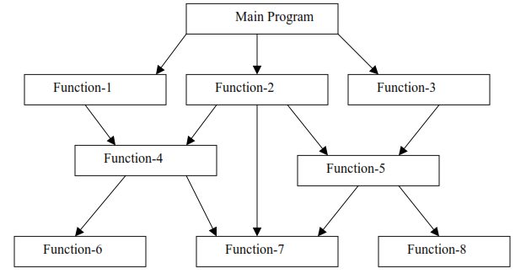
Fig 1:1 : A typical structure for procedural programming

Slide 17
Features of Structured Programming
Emphasis is on doing things (algorithms)
Large programs are divided into smaller programs known as functions
Most of the functions share global data.
Data move openly around the system from function to function.
Functions transform data from one form to another.
Employs top-down approach in program design.

Slide 18
2. Object Oriented Programming Paradigms
OOP organizes a program around its data (that is, objects) and a set of well-defined interfaces to that data.
This approach or paradigm is useful to manage the complexity of the program
An object oriented program can be characterized as data controlling access to code.
OOP allows to decompose a problem into a number of entities called objects and then build data and methods (functions) around these entities.
OOP can help in developing much larger and complex programs than structured programming.

Slide 19
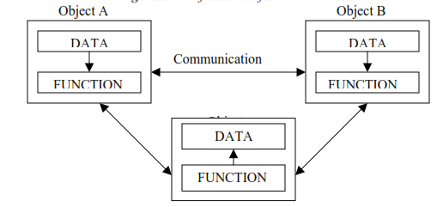
Fig 1.2 : Shows the organization of data and methods in object-oriented programs.
The data of an object can be accessed only by the function (methods) associated with that object.
However, function (method) of one object can access the function (method) of other objects

Slide 20
Features of object oriented programming
Emphasis is on data rather than procedure.
Programs are divided into what are known as objects.
Data structures are designed such that they characterize the objects.
Functions (methods) that operate on the data of an object are ties together in the data structure.
Data is hidden and cannot be accessed by external function.
Objects may communicate with each other through function.
New data and functions can be easily added whenever necessary.
Follows bottom up approach in program design.

Slide 21
1.2 Structured Programming Vs Object Oriented Programming
Structured Programming | Object Oriented Programming
Both functions and the data is considered separate because data structures are not well organized within the program | Data and methods are tied together since variables and methods are well organized under structure or classes
Programs are divided into small self contained functions | Programs are divided in to small entities is called objects
Functions or procedures are the basic units of manipulation in structured programming | Objects are the basic units of manipulation in object oriented programming

Slide 22
Structured Programming | Object Oriented Programming
Follows top-down approaches | Follows bottom-up approaches
A program is focused on manipulation of data. | Focused on the manipulation of both data and on methods.
Structured programming is less secure as there is no way of data hiding | Data is hidden within the objects and its manipulation can be strictly controlled in OOP
Structured Programming misses reuses of classes, codes and inheritance | OOP supports reuses of classes and their parts of the code and supports the inheritance of state and behavior

Slide 23
1.3 Basic Concepts of Object Oriented Programming
These include:
Objects
Classes
Data Abstraction and Encapsulation
Inheritance
Polymorphism
Dynamic Binding
Message Passing

Slide 24
1.3.1 Objects
Objects are the basic run time entities in an object-oriented programming paradigm.
They may represent a person, a place, a bank account, a table of data or any item that the program has to handle.
Programming problem is analyzed in terms of objects and the nature of communication between them.
Program objects should be chosen such that they match closely with the real-world objects.
Objects take up space in the memory and have an associated address.
When a program is executed, the objects interact by sending messages to one another.

Slide 25
Foe example:
If “customer” and “account” are two object in a program, then the customer object may send a message to the account object requesting for the bank balance.
Each object contain data, and code to manipulate data.
Objects can interact without having to know details of each other’s data or code.
It is a sufficient to know the type of message accepted, and the type of response returned by the objects.

Slide 26
1.3.2 Classes
Class introduces a new data type i.e.; describes a set of objects that have identical characteristics (data elements) and behaviors (methods).
Class defines what all objects of the class represents.
It is a template (blue print) that represent what the object looks like or to model the real world.
Shortly it defines the shape and nature of an object
The entire set of data and code of an object can be made a user-defined data type with the help of class.
In fact, objects are variables of the type class.

Slide 27
Once a class has been defined, we can create any number of objects belonging to that class.
Each object is associated with the data of type class with which they are created.
A class is thus a collection of objects similar types.
For examples, Mango, Apple and orange members of class fruit.
Classes are user-defined data types and behave like the built-in types of a programming language.
If fruit has been defines as a class, the statement Fruit.Mango; will create an object mango belonging to the class fruit.

Slide 28
1.3.3 Data Abstraction and Encapsulation
The wrapping up of data and methods into a single unit (called class) is known as encapsulation.
Data and encapsulation is the most striking feature of a class.
The data is not accessible to the outside world, and only those functions which are wrapped in the class can access it.
These functions provide the interface between the object’s data and the program.
This insulation of the data from direct access by the program is called data hiding or information hiding.
Abstraction refers to the act of representing essential features without including the background details or explanation.

Slide 29
Classes use the concept of abstraction and are defined as a list of abstract attributes such as size, wait, and cost, and function operate on these attributes.
They encapsulate all the essential properties of the object that are to be created.
The attributes are some time called data members because they hold information.
The functions that operate on these data are sometimes called methods or member function.

Slide 30
1.3.4 Inheritance
Inheritance is the process by which objects of one class acquired the properties of objects of another classes.
It supports the concept of hierarchical classification.
The principal is that each derived class shares common characteristics with the class from which it is derived
In OOP, the concept of inheritance provides the idea of reusability.
This means that we can add additional features to an existing class without modifying it.
This is possible by deriving a new class from the existing one.

Slide 31
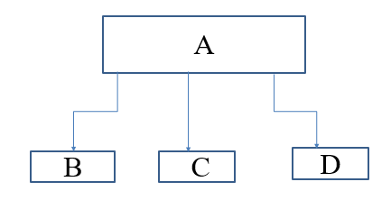
The new class will have the combined feature of both the classes.
In hierarchical inheritance type of a class one parent class will be inherited by many sub-classes.
For example in the figure below class A will be inherited by class B, C and D respectively. Class A will be acting as a parent class for B, C and D and class B, C and D are acting as a sub class or child class.

Slide 32
1.3.5 Polymorphism
Polymorphism, a Greek term, means the ability to take more than one form.
An operation may exhibit different behavior in different instances.
The behavior depends upon the types of data used in the operation.
For example, consider the operation of addition.
For two numbers, the operation will generate a sum.
If the operands are strings, then the operation would produce a third string by concatenation.

Slide 33
The process of making an operator to exhibit different behaviors in different instances is known as operator overloading.
Fig. 1.5. illustrates that a single function name can be used to handle different number and different types of argument.
This is something similar to a particular word having several different meanings depending upon the context.
Using a single function name to perform different type of task is known as function overloading.

Slide 34
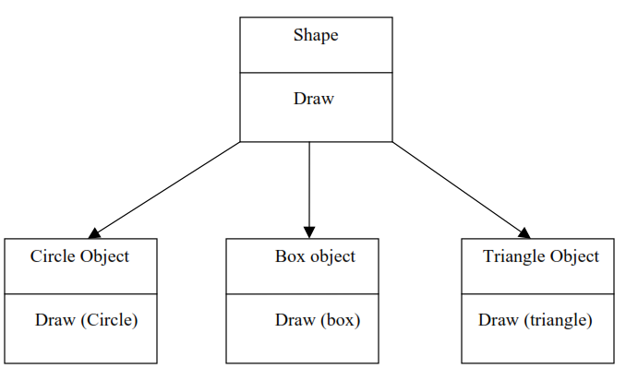
Polymorphism plays an important role in allowing objects having different internal structures to share the same external interface.
This means that a general class of operations may be accessed in the same manner even though specific action associated with each operation may differ.
Polymorphism is extensively used in implementing inheritance.

Slide 35
1.3.6 Dynamic Binding
Dynamic binding also called dynamic dispatch is the process of linking procedure call to a specific sequence of code (method) at run-time.
It means that the code to be executed for a specific procedure call is not known until run-time.
Dynamic binding is also known as late binding or run-time binding
Dynamic binding is an object oriented programming concept and it is related with polymorphism and inheritance

Slide 36
Dynamic binding(dispatch) means that a block of code executed with reference to a procedure(method) call is determined at run time.
Dynamic dispatch is generally used when multiple classes contain different implementations of the same method.
It provides a mechanism for selecting the function to be executed from various function alternatives at the run-time.

Slide 37
1.3.7 Message Passing
An object-oriented program consists of a set of objects that communicate with each other.
The process of programming in an object-oriented language, involves the following basic steps:
1. Creating classes that define object and their behavior,
2. Creating objects from class definitions, and
3. Establishing communication among objects.
Objects communicate with one another by sending and receiving information
The concept of message passing makes it easier to talk about building systems that directly model or simulate their real-world counterparts.

Slide 38
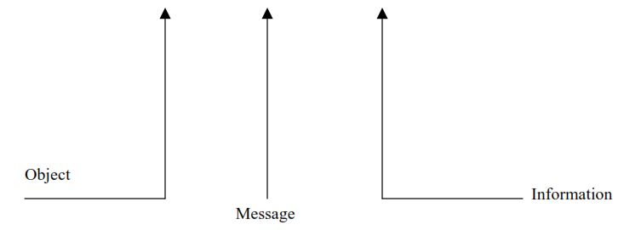
A Message for an object is a request for execution of a procedure, and therefore will invoke a function (procedure) in the receiving object that generates the desired results.
Message passing involves specifying the name of object, the name of the function and the information to be sent.
Example: Employee. Salary (name);

Slide 39
1.4 Benefits of OOP
1. Ability to reflect the real world
Every Entity in the real world can be expressed as an object in OOP.
An Object is an entity which has state and behavior.
Eg. Dog is a real world entity
It has state: breed, color etc.,
It has a behavior: barks, eats etc.,
It can be expressed as Object, by defining state and behavior in the class.

Slide 40
2. Re-usability
Reusing some facilities rather than building them again and again.
This is done with the use of a class.
3. Data Redundancy
Place of data storage (you can say Databases) where the same piece of data is held in two separate places.
So data redundancy is one of the greatest advantages of OOP.
If a user wants a similar functionality in multiple classes, he/she can go ahead by writing common class definitions for similar functionalities and inherit them.

Slide 41
4. Code Maintenance
It helps users from doing re-work in many ways.
Easy and time-saving to maintain and modify the existing codes by incorporating new changes into them.
5. Security
With the use of data hiding and abstraction mechanism, we are filtering out limited data to exposure, which means we are maintaining security and providing necessary data to view.
6. Design Benefits
Benefit a user will get is in terms of designing and fixing things easily and eliminating the risks.

Slide 42
Here the Object-Oriented Programs forces the designers to have a long and extensive design phase, which results in better designs and fewer flaws.
7. Easy Troubleshooting
Using encapsulation in OOP; all the objects are self-constrained with this modality behavior,
the IT teams get a lot of work benefits as they are now capable of working on multiple projects simultaneously with an advantage that there is no possibility of code duplicity.

Slide 43
8. Polymorphism Flexibility
Polymorphism is flexible and helps developers in a number of ways.
It’s simplicity
Extensibility
9. Problems solving
Decomposing a complex problem into smaller chunks or discrete components is a good practice.
OOP is specialized in this behavior, as it breaks down your software code into bite-sized-one object at a time.

Slide 44
The broken components can be reused in solutions to different other problems (both less and more complex),
or either they can be replaced by the future modules that relate to the same interface with implementations details.

Slide 45
1.5 Limitations of Object Oriented Programming
It is possible that the relation among all the available classes become artificial that may cause difficulties in the development.
Programs developed with OOP language are large in size and also requires additional resources for its implementation which can lead to runtime overhead issues
The concepts included in OOP are a bit more complex than the procedural programming languages.
Thus, it might become difficult for programmers to understand their complex working in the initial development phase.

Slide 46
For instance-concepts of polymorphism, abstraction and inheritance are little hard to comprehend.
Therefore, it can be said that programming using OOP requires a specialized skill set in developing program logics.
Otherwise, it may become difficult for programmers to manage and debug the code.
The increased line of code will have a significant impact on the processing time.
This is because of the instructions that are added in the program logic and thereby these instructions will require comparatively more processing time for its execution.

Slide 47
Majority of programs created using the Object Oriented model are more efficient and flexible in nature, yet there are some limitations to it.
One such limitation is the inability of these programs to fit in every situation.
In such cases, other programming languages such as functional or other procedural programming languages are more suitable to solve such problems.
There is another functionality of message passing in OOP methodology which enables objects of different classes to share data using message passing techniques.

Slide 48
However, in the case of complex software applications, it might be a challenging task to track messages among different instances.
Thus, it increases overall processing time in debugging of software modules.
Due to the large size of the program, there is a need to execute more instructions.

Slide 49
1.6 Application of OOP
1. Real-Time Systems Design
A system is said to be Real-Time if it is required to complete its work and delivers its services on time i.e Flight Control System etc.
Object-oriented techniques make it easier to control the complexities related to real-time system design.
These techniques give an integrated framework which involves the schedule ability analysis and developmental specifications.

Slide 50
1.6 Application of OOP continued
It has two main types
Hard Real-Time System
Purely deterministic and 100% time constraint system
i.e Satellite launching stations, Missile launching stations and Air Bags Controls in cars etc.
B. Soft Real-Time System
The meeting of the deadline is not compulsory for every time or for every task but the process should processed and give the result
i.e personal computers, audio and video systems etc.

Slide 51
1.6 Application of OOP continued
2. Simulation and Modelling System
The varying specification of variables makes it difficult to build complex systems such as ecology, zoology, and agronomic systems.
Modelling and understanding interactions explicitly are required for simulating complex systems.
Object-oriented Programming gives the substitute approach for making these complex modelling systems easier
3. Object-Oriented Database
Object-oriented database enables us to represent data in the form of objects.
It permits developers to model complex data easily and captures the relationships in a natural way.

Slide 52
1.6 Application of OOP continued
It is also known as Object Database Management Systems (ODBMS).
To let the object maintain their identity and integrity, these databases try to balance a relationship between the real-world and database objects.
Identities of objects are identified and operations are then performed on these objects.
4. Client-Server System
A client-server is a software structural design model comprises of client systems and server systems, both of which communicate over a computer network or may communicate on the same computer.

Slide 53
1.6 Application of OOP continued
Because of object-oriented programming, Client-Server Systems offer the IT infrastructure i.e operating systems, networks, and hardware etc, creating object-oriented Client-Server Internet (OCSI) applications.
These applications have three major technologies:
The Client Server
Object-Oriented Programming
The Internet
These models have also structural functionality for email exchange and Web/database access.

Slide 54
1.6 Application of OOP continued
5. Hypertext, Hypermedia
Hypertext means text augmented with links.
Hypertext is basically similar to that of regular text as it can be stored, searched, and edited effortlessly.
The main disparity of hypertext is text with pointers to other text as well.
Hypermedia is an extension to hypertext that gives facilities like handling sound and video.
Documents having hypermedia, not only have links to other pieces of text but also to various other forms of media, varies from images to sound.

Slide 55
1.6 Application of OOP continued
6. Neural Networking and Parallel Programming
It is very useful in addresses the setback of prediction and estimation of complex time-varying systems.
Firstly, the whole time-varying process is divided into numerous time intervals.
Then, neural networks are developed in a specific time interval to scatter the load of several networks.
OOP simplifies the whole process by simplifying the estimation and prediction capability of networks

Slide 56
1.6 Application of OOP continued
7. Office Automation Systems
These involve formal and informal electronic systems mainly concerned with information sharing and communication to and from people inside as well as external of the association i.e email, Word processing, Web calendars, Desktop publishing etc.
8. CIM/CAD/CAM Systems
OOP can also be used in developing and designing the applications as it allows people to trim down the effort involved.
Such as, it is used in designing blueprints, flowcharts, etc.
OOP makes it easier for the designers and engineers to produce these flowcharts and blueprints perfectly.

Slide 57
1.6 Application of OOP continued
9. AI Expert Systems
Computer applications which use databases of expert knowledge to make decisions in many areas as medical diagnosis.
Their advice and decisions are beyond the reach of a human brain as they are reliable, highly responsive and understandable.
There are many more applications of OOP that is widely used in developing and designing applications such as office automation systems etc.
It reduces the effort involved in manufacturing applications.

Slide 58
Activity 1
Write the difference between C++ and Java programming from the object oriented programming point of view?
Write short difference between Structured and Object Oriented Programming paradigms by giving examples.
Explain about the basic Object Oriented concepts such as class, objects, inheritance, encapsulation, polymorphism, message passing and dynamic dispatch (binding) by giving examples.
Write the benefits of Object Oriented Programming over structured programming paradigms.
Write the limitations of Structured Programming paradigm and Object Oriented Programming Paradigms.
List down and explain the areas of application of Object Oriented Programming language by giving examples.

Slide 59
1. 7 What is Java?
Java is a general-purpose, class-based, object-oriented programming language designed for having lesser implementation dependencies.
Java is a programming language and multi-platform, object-oriented, and network-centric language.
It is a computing platform for application development.
Java is fast, secure, and reliable.
Therefore, it is widely used for developing Java applications in laptops, data centers, game consoles, scientific supercomputers, cell phones, and reliable programming.

Slide 60
1.8 Applications of Java Programming Languages
Mobile App Development
Desktop GUI Applications
Web-based Applications
Gaming Applications
Big Data Technologies
Distributed Applications
Cloud-based Applications
IoT Applications
Scientific Computing Applications
Java Programming of Hardware devices
Used for Server-Side Technologies like Apache, JBoss, GlassFish, etc.

Slide 61
1.9 Java Platform
Java platform is a collection of programs that helps to develop and executes programs written in Java programming language.
Java platform is independent of any particular OS or not specific to any processor which makes Java programming language a platform-independent language.
Java platform consists of the following components.
Java Language,
Java Compiler
Java Virtual Machine (JVM)
Java Runtime Environment (JRE) and
Java Development Kit (JDK)

Slide 62
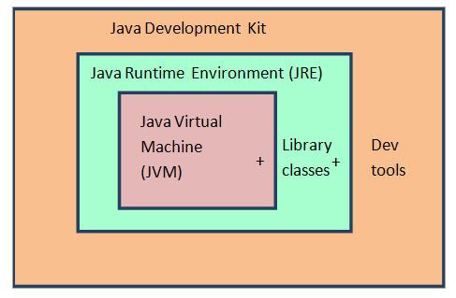
1.9 Java Platform continued
Java platform also contains garbage collectors, a set of libraries, an execution engine and other additional components and tools that are required to efficiently to develop and run Java applications.
Let’s consider the following diagram that depicts the relationship between all these components.

Slide 63
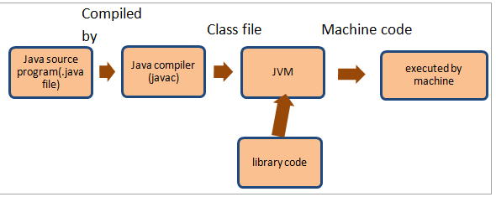
1.9 Java Platform continued
So from the above diagram, we can conclude that:
JDK = JRE + Developer tools
JRE = JVM + library + classes
The following diagram shows the flow of a Java program.

Slide 64
1.9 Java Platform continued
So the diagram in the previous slide shows a simple execution flow for a Java program.
A program written in Java language is compiled by the Java compiler (javac).
The Javac compiler generates a class file consisting of byte code.
Now, this class file is given to Java Virtual Machine (JVM) that translates the class file into an object file containing machine-independent code.
Then this code is executed by the machine.

Slide 65
1.10 Components of Java Platform
1. Java Language
Java is a programming language that the Java platform uses.
Java is an object-oriented programming language whose syntax is derived from C and OOPs features are derived from C++.
It has its syntax, rules, format, and programming paradigm.
2. Java Compiler
This is a compiler for Java programming language and its function is to generate Java class files from the Java source code.
Java class file contains a platform-independent Java byte code.

Slide 66
1.10 Components of Java Platform continued
After generating class files, JVM loads these class files and either interprets the byte code or compiles it to machine code using Just-in-time (JIT) compiler.
3. Java Virtual Machine (JVM)
JVM is the center of Java programming language and Java platform.
The JVM performs the following operation:
Loads code
Verifies code
Executes code
Provides runtime environment

Slide 67
1.10 Components of Java Platform continued
JVM also provides the functionality of garbage collection, memory management, security, etc.
JVM is platform-independent and we can customize its functionality using a Virtual interface it provides which is not machine-dependent and is also independent of the operating system.
This platform-independence of JVM allows us to create Java programs on one machine and execute them on another machine (WORA – Write – Once – Run – Anywhere).

Slide 68
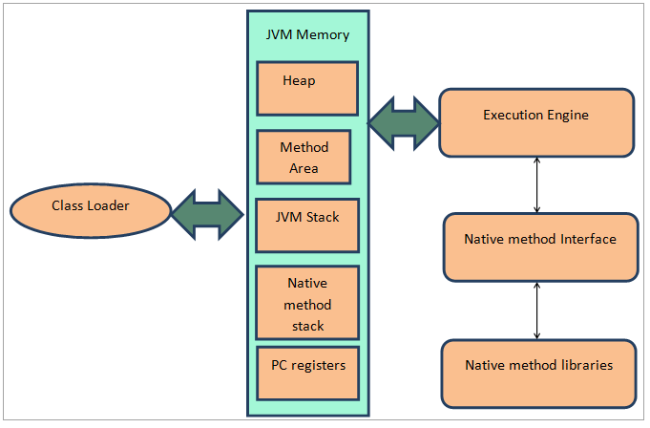
1.10 Components of Java Platform continued
The following diagram illustrates the various parts of a JVM.

Slide 69
3.1 Components of JVM
Classloader
The JVM is present on the RAM.
When the Java program is converted to a class file by the Java compiler, it needs to be executed.
For execution, the class file is brought on the RAM by the class loader.
Here the BYTE code is verified for any security issues.
Classloader is a subsystem of JVM which is used to load class files whenever we need to run the java program.
Class loader is also responsible for linking and initialization of the program to be executed.

Slide 70
3.1 Components of JVM continued
2. PC registers that contain current instruction to be executed,
3. Heap which holds variables, arrays, etc.
4. Method Area and Native Method Stack which contains method code and native language specification respectively.
5. JVM Stack holds the instance of the program or the current thread.
If there is more than one thread than each thread will have its JVM stack
6. Execution Engine
Once the program is properly linked, then it is passed on to the execution engine.

Slide 71
3.1 Components of JVM continued
The execution engine cooperates with the native method interface and native method libraries.
Native method interface is a programming framework that allows Java code to call libraries and native applications that are a part of the native method libraries.
Next, the execution engine converts the bytecode into Native machine code using just-in-time (JIT) compiler.
Then the program is executed by the machine.

Slide 72
3.1 Components of JVM continued
Note:
JIT or Just-in-time compiler is a part of the Java Virtual Machine (JVM).
It interprets a part of the Byte Code that has similar functionality at the same time.
In other words, it converts the byte code into native machine code at the same programming level.
This is the reason for which Java is compiled as well as an interpreted language.

Slide 73
4. Java Runtime Environment (JRE)
JRE, is the runtime environment that is required to execute Java programs and applications.
JRE consists of Java Virtual Machine and libraries and other classes to successfully execute Java programs.
JRE is a subset of JDK and doesn’t contain any development tools such as Java compiler, debugger, etc.
Hence if your Java applications are developed elsewhere, and you need to only execute them on your machine, then you can install JRE separately.
You do need to install JDK for this.

Slide 74
4. Java Runtime Environment (JRE) continued
You need a JRE installed on your machine as it’s the minimum requirement to run Java programs on your machine.
The JRE includes the following components.
Code libraries, property settings, and resource files:
These include files like charsets.jar, rt.jar, etc.
DLL files: Used by Java hotspot client virtual machine and server virtual machine.
Java extension files: For Example, files related to locale specification like localedata.jar

Slide 75
4. Java Runtime Environment (JRE) continued
Files required for security management. For Example, java.policy, java.security
Applet support classes.
True Type font files: Usually required by the platform.
To execute any application/program written in Java, you need JRE installed on your system.
JRE is platform dependent.
This means you need to download and install JRE that’s compatible with your OS and architecture.

Slide 76
5. Java Development Kit (JDK)
This is the core component of any Java environment.
JDK contains JRE (Java Runtime Environment) along with Java compiler, Java debugger, and other core classes.
JDK is used for Java development as it provides the entire executable and libraries as well as tools required to compile, debug a Java program.
JDK is a platform-specific software and thus we will have separate JDK installers for each operating system.
JDK contains the following components:
jConsole: This is a Java monitoring and management Console.

Slide 77
5. Java Development Kit (JDK) continued
jar: This is the archiver. This tool is used to package related class libraries into a single Jar file as well as to manage Jar files.
jarSigner: This tool is used for jar signing and verifying.
javap: This is a tool for class file disassembler.
javaws: Java web start launcher for JNLP applications.
jhat: Java heap analysis tool.
jrunscript: Java command-line script shell.
jstack: Utility used to print stack traces for Java threads.
Javadoc: This automatically generates documentation from the source code comments.

Slide 78
5. The Java Development Kit (JDK) continued
appletviewer: Used for applet execution and debugging without a web browser.
apt: Annotation processing tool.
extCheck: Utility used to check jar file conflicts.
keytool: Using this utility you can manipulate Keystore.
policytool: This is a policy creation and management tool.
xjc: This is a part of the XML binding (JAXB) API that accepts XML schema and generates Java classes.
Thus you can see that the components of JDK are the ones that are required by us from a development point of view.

Slide 79
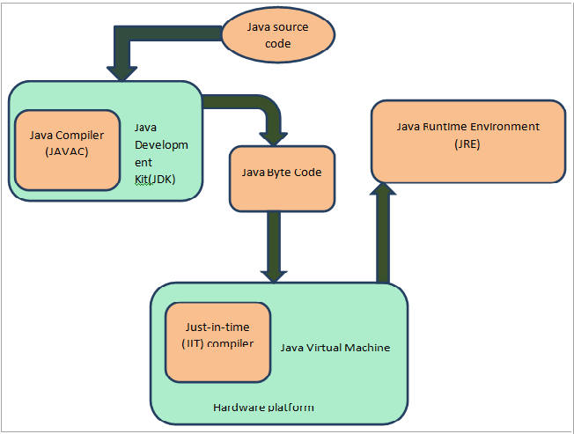

Slide 80
5. The Java Development Kit (JDK) continued
As shown the diagram in the previous slide:
The Java source code is converted to byte codes by Java compiler which is a part of JDK.
Then this byte code is passed on to JVM and from there it goes to JRE where the code is executed.
Having seen the details about JDK and JRE, now let’s discuss the differences between JRE and JDK.

Slide 81
JRE Vs JDK
JRE | JDK
Mostly used for the execution of Java programs. | JDK is used by developers for developing Java programs.
JRE contains Java Virtual machine (JVM) bundled inside it. | JDK doesn’t have JVM.
JRE doesn’t have Java compiler so cannot compile programs. | JDK has javac compiler and is responsible for compiling programs.

Slide 82
JRE Vs JDK continued
JRE | JDK
JRE contains java class library, the java command, and other infrastructure. | JDK contains tools like Javadoc and archiver-used to develop Java applications.
JRE can be installed as a standalone program. | JDK is a separate installer and comes bundled with JRE.
JRE takes the compiled/interpreted Java program as input and generates output. | JDK take java source program and javac compiler and generates a class file which is then given to JVM.

Slide 83
1.11 Different Types of Java Platforms
Java Platform, Standard Edition (Java SE)
Java SE's API offers the Java programming language's core functionality.
It defines all the basis of type and object to high-level classes.
It is used for networking, security, database access, graphical user interface (GUI) development, and XML parsing.
2. Java Platform, Enterprise Edition (Java EE)
The Java EE platform offers an API and runtime environment for developing and running highly scalable, large-scale, multi-tiered, reliable, and secure network applications.

Slide 84
1.11 Different Types of Java Platforms continued
3. Java Programming Language Platform, Micro Edition (Java ME)
The Java ME platform offers an API and a small-footprint virtual machine running Java programming language applications on small devices, like mobile phones.
4. Java FX
JavaFX is a platform for developing rich internet applications using a lightweight user-interface API.
It uses hardware-accelerated graphics and media engines that help Java take advantage of higher-performance clients and a modern look-and-feel and high-level APIs for connecting to networked data sources.

Slide 85
1.12 Features of Java
The primary objective of Java programming language creation was to make it portable, simple and secure programming language.
Apart from this, there are also some excellent features which play an important role in the popularity of this language.
The features of Java are also known as java buzzwords.
A list of most important features of Java language is given in the next slide.

Slide 86
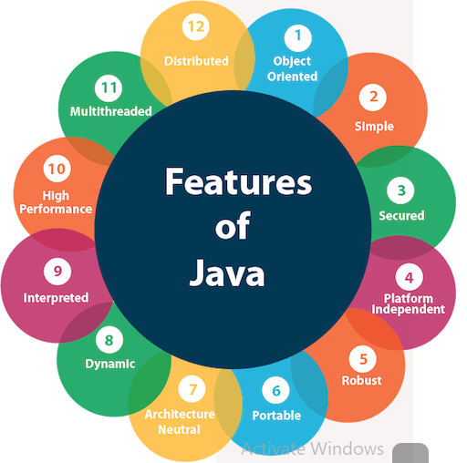
1.12 Features of Java continued

Slide 87
1.12 Features of Java continued
1. Simple
Java is very easy to learn, and its syntax is simple, clean and easy to understand.
According to Sun, Java language is a simple programming language because:
Java syntax is based on C++ (so easier for programmers to learn it after C++).
Java has removed many complicated and rarely-used features, such as, explicit pointers, operator overloading, etc.
There is no need to remove unreferenced objects because there is an Automatic Garbage Collection in Java.

Slide 88
1.12 Features of Java continued
2. Object-oriented
Java is an object-oriented programming language.
Everything in Java is an object.
Object-oriented means we organize our software as a combination of different types of objects that incorporates both data and behavior.
Object-oriented programming (OOPs) is a methodology that simplifies software development and maintenance by providing some rules.

Slide 89
1.12 Features of Java continued
OOP has several advantages over procedural programming:
OOP is faster and easier to execute
OOP provides a clear structure for the programs
OOP helps to keep the Java code DRY "Don't Repeat Yourself", and makes the code easier to maintain, modify and debug
OOP makes it possible to create full reusable applications with less code and shorter development time
Classes and objects are the two main aspects of object-oriented programming.

Slide 90
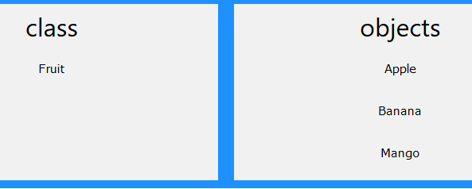
1.12 Features of Java continued
So, a class is a template for objects, and an object is an instance of a class.
When the individual objects are created, they inherit all the variables and methods from the class.
Look at the following illustration to see the difference between class and objects:

Slide 91
1.12 Features of Java continued
3. Platform Independent
Java is platform independent because it is different from other languages like C, C++, etc. which are compiled into platform specific machines while Java is a write once, run anywhere language.
A platform is the hardware or software environment in which a program runs
There are two types of platforms software-based and hardware-based. Java provides a software-based platform

Slide 92
1.12 Features of Java continued
The Java platform differs from most other platforms in the sense that it is a software-based platform that runs on the top of other hardware-based platforms.
Java code can be run on multiple platforms, for example, Windows, Linux, Sun Solaris, Mac/OS, etc.
Java code is compiled by the compiler and converted into bytecode.
This bytecode is a platform-independent code because it can be run on multiple platforms, i.e., Write Once and Run Anywhere(WORA).

Slide 93
1.12 Features of Java continued
4. Secured
With Java, we can develop virus-free systems. Java is secured because:
No explicit pointer
Java programs run inside a virtual machine sandbox
Classloader
Classloader in Java is a part of the JRE which is used to load Java classes into the Java Virtual Machine dynamically.
It adds security by separating the package for the classes of the local file system from those that are imported from network sources.

Slide 94
1.12 Features of Java continued
Bytecode Verifier
It checks the code fragments for illegal code that can violate access right to objects.
Security Manager
It determines what resources a class can access such as reading and writing to the local disk.
Java language provides these securities by default.
Some security can also be provided by an application developer explicitly through SSL, JAAS, Cryptography, etc.

Slide 95
1.12 Features of Java continued
5. Robust
Robust simply means strong. Java is robust because:
It uses strong memory management.
There is a lack of pointers that avoids security problems.
There is automatic garbage collection in java which runs on the Java Virtual Machine to get rid of objects which are not being used by a Java application anymore.
There are exception handling and the type checking mechanism in Java.
All these points make Java robust.

Slide 96
1.12 Features of Java continued
6. Architecture-neutral
Java is architecture neutral because there are no implementation dependent features, for example, the size of primitive types is fixed.
In C programming, int data type occupies 2 bytes of memory for 32-bit architecture and 4 bytes of memory for 64-bit architecture.
However, it occupies 4 bytes of memory for both 32 and 64-bit architectures in Java.

Slide 97
1.12 Features of Java continued
7. Portable
Java is portable because it facilitates you to carry the Java bytecode to any platform. It doesn't require any implementation.
8. High-performance
Java is faster than other traditional interpreted programming languages because Java bytecode is "close" to native code.
It is still a little bit slower than a compiled language (e.g., C++).

Slide 98
1.12 Features of Java continued
Java is an interpreted language that is why it is slower than compiled languages, e.g., C, C++, etc.
9. Distributed
Java is distributed because it facilitates users to create distributed applications in Java.
RMI and EJB are used for creating distributed applications.
This feature of Java makes us able to access files by calling the methods from any machine on the internet.
10. Multi-threaded
A thread is like a separate program, executing concurrently.

Slide 99
1.12 Features of Java continued
We can write Java programs that deal with many tasks at once by defining multiple threads.
The main advantage of multi-threading is that it doesn't occupy memory for each thread.
It shares a common memory area.
Threads are important for multi-media, Web applications, etc.
11. Dynamic
Java is a dynamic language that supports dynamic loading of classes.
It means classes are loaded on demand.

Slide 100
1.12 Features of Java continued
It also supports functions from native languages, i.e., C and C++.
Java supports dynamic compilation and automatic memory management (garbage collection).
12. Interpreted
The Java interpreter can execute Java bytecodes directly on any machine to which the interpreter has been ported.
Since linking is a more incremental and lightweight process, the development process can be much more rapid and exploratory.
13. Java Applets
Java provides Applets to employ a modern graphical interface with buttons, text fields, text areas, radio buttons, and so on, to interact with users on the Web and process their requests.

Slide 101
1.12 Features of Java continued
Applets make the web responsive, interactive, and fun to use.
Applets are embedded in an HTML file.
HTML is a simple scripting language for laying out documents, linking documents on the Internet, and bringing images, sound, and video alive on the Web.
Today, you can use Java to develop rich Internet applications.
A Rich Internet application (RIA) is a Web application designed to deliver the same features and functions normally associated with desktop applications.
Java is now very popular for developing applications on Web servers.

Slide 102
1.12 Features of Java continued
These applications process data, perform computations, and generate dynamic Web pages.
Many commercial Websites are developed using Java on the backend.
14. Versatile
Java is a versatile programming language.
It is used to develop applications for desktop computers, servers, and small handheld devices.
The software for Android cell phones is developed using Java.

Slide 103
1.13 Activity
Explain the term Java and why Java is used and list down the applications of Java programming languages?
What is Java platform and list down and explain the java platform components?
Write short difference between Java Development Kit(JDK) and Java Runtime Environment (JRE) components of java platform
What is the Java source filename extension, and what is the Java bytecode filename extension?
What are the input and output of a Java compiler?
What is the command to compile and run a Java program?

Slide 104
1.13 Activity continued
7. What is JVM and show the architecture of JVM graphically and explain the purpose of each components of the JVM?
8. Can Java run on any machine? What is needed to run Java on any computer?
9. List down and explain the features of java or buzzwords?
10. List down the most common types of Java platform and explain the purpose of each types of the platform?

